Slide 1


PLATO’S PIZZA SALES
Tools & Technologies Used
Data Processing: Microsoft Excel
Data Visualization: Tableau
Data Analysis: SQL for querying sales data

Slide 2
INTRODUCTION
Plato’s Pizza Sales Dashboard
Objective
To analyze and visualize the sales performance of Plato’s Pizza, providing actionable insights into revenue, order trends, pizza size preferences, and top-selling products to drive data-driven business decisions.
Key Insights Covered
Total revenue, total orders, and average revenue per order
Peak sales hours for better operational planning
Most popular pizza sizes and top-selling pizzas
Revenue trends by month and day of the week

Slide 3
DASHBOARD CREATED IN MS EXCEL charts explanation
Top 5 Pizzas by Total Orders: Displays the most popular pizzas based on order volume, highlighting customer preferences.
Bottom 10 Selling Pizzas: Shows the least popular pizzas, providing insights for menu optimization.
Sales by Pizza Size: Visualizes the distribution of sales across pizza sizes (Small, Medium, Large), useful for understanding size preferences.
Total Revenue by Day: Tracks daily revenue trends, helping identify peak sales days.

Slide 4
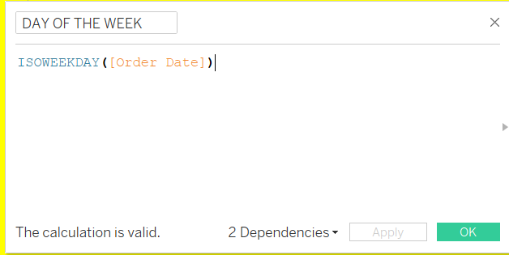
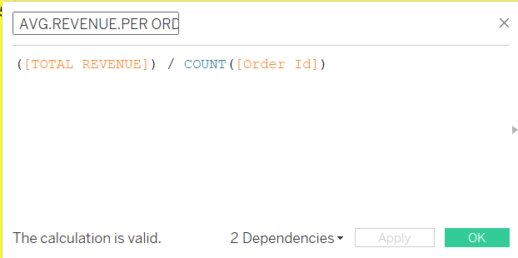
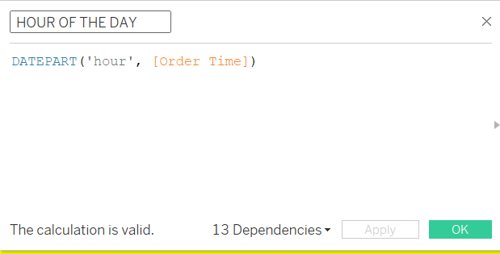
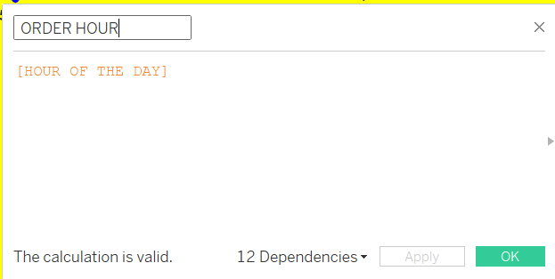
PLATO’S PIZZA SALES DATA ANALYSIS IN TABLEAU (CALCULATED FIELDS)

Slide 5
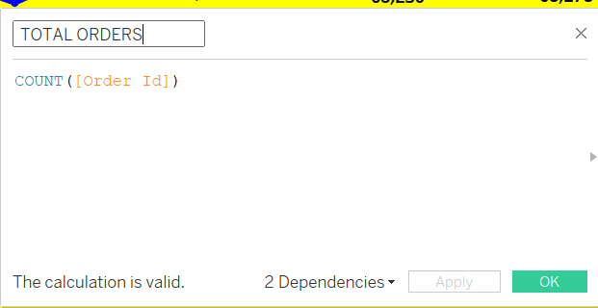
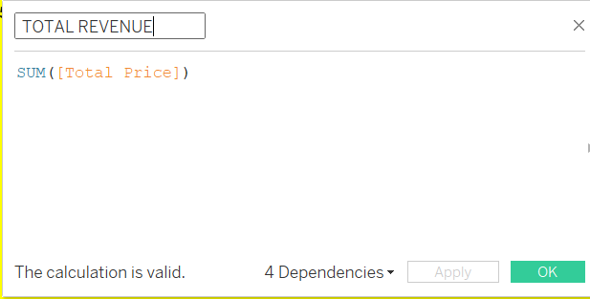
CALCULATED FIELDS

Slide 6
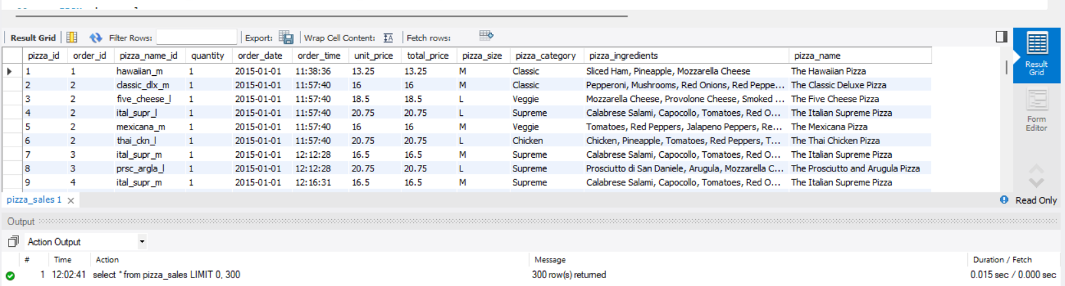
PLATO’S PIZZA SALES ANALYSIS IN MYSQL

Slide 7
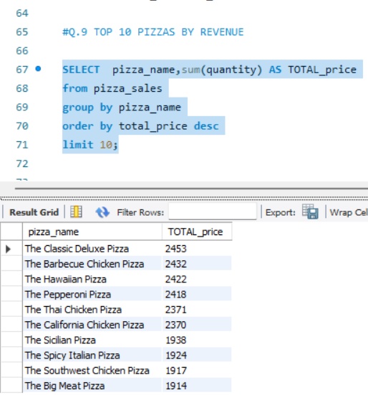
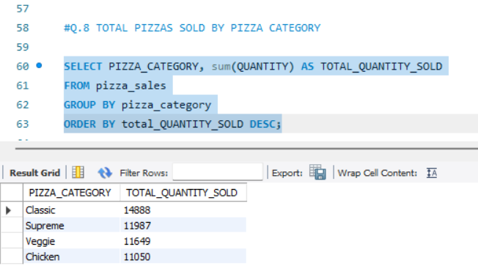
SQL QUERIES

Slide 8
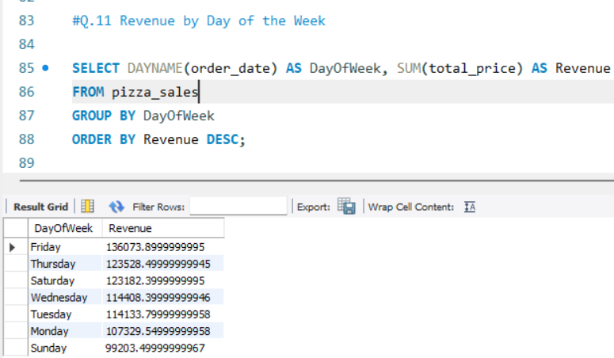
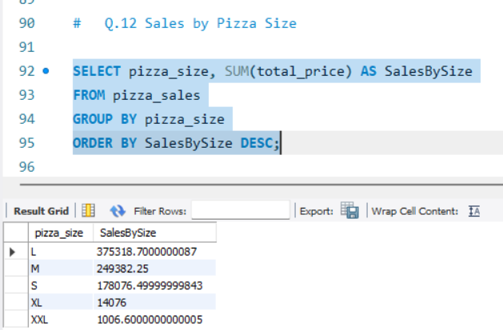
FOCUSED QUERIES

Slide 9

KEY INSIGHTS FROM DASHBOARD
Top-Selling Pizzas: Focus on promoting best-selling pizzas like The Classic Deluxe Pizza and The Barbecue Chicken Pizza.
Peak Sales Hours: Target marketing efforts during peak sales hours to maximize revenue.
Revenue by Day of the Week: Leverage days with higher sales for promotional offers and discounts.
Pizza Size Preferences: Cater to demand by prioritizing production and inventory for Large and Medium pizza sizes.

Slide 10

Proposed Strategies
1. Personalized Marketing Campaigns
Utilize customer data to create tailored offers (e.g., "Buy 1 Get 1 Free" during peak hours).
Engage with customers via SMS/email campaigns featuring best-selling pizzas.
2. Menu Optimization
Highlight popular pizzas on the menu and optimize pricing to encourage higher sales.
Experiment with seasonal or limited-time flavors to attract repeat customers.
3. Incentives & Promotions
Offer discounts on slower days or non-peak hours to boost sales.
Introduce loyalty programs to retain customers and increase repeat orders.
4. Operational Enhancements
Ensure sufficient stock of ingredients for top-selling pizzas during peak times.
Optimize delivery operations for faster service during high-demand hours.

Slide 11

Actionable Strategies
Promote top-selling pizzas and peak sales hours with targeted discounts.
Optimize inventory for popular sizes and ingredients.
Implement loyalty programs to encourage repeat purchases.
Monitor trends for dynamic marketing campaigns.

Slide 12
SUMMARY
KEY INSIGHTS
TOTAL REVENUE: ₹818K generated from 49K orders
TOP SELLING PIZZAS: The Classic Deluxe Pizza and the Barbecue Chicken Pizza
POPULAR PIZZA SIZES: Large (18,956 units) and Medium (15,635 units) are customer favorites.
PEAK SALES HOURS: Highest revenue during specific time slots (₹774K).

